Slide 1


THE BEST MEDICAL UNIVERSITY
IN POLAND
More than 650 years
of experience in teaching and research

Slide 2
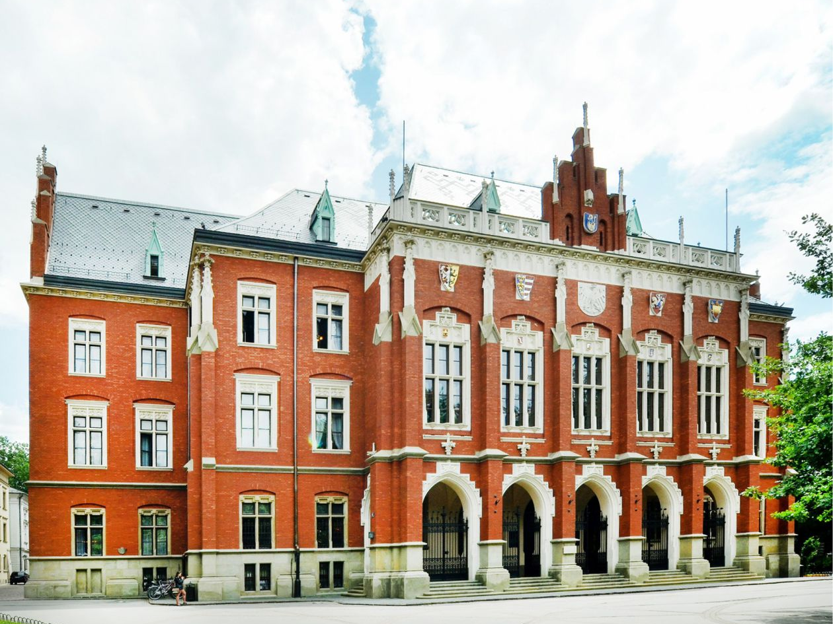
Jagiellonian University

Slide 3









Jagiellonian University
2023
16 faculties
177 majors
94 degree courses
4000 academic teachers and researches
40 000 students, PhD students
and postgraduate students
modern research centers
cooperation with prestigious foreign universities
leading teaching center
one of Europe’s
oldest universities
notable alumni:
Nicolaus
Copernicus
Pope
John Paul II
Wisława Szymborska
Nobel Prize winner
in literature 1996

Slide 4
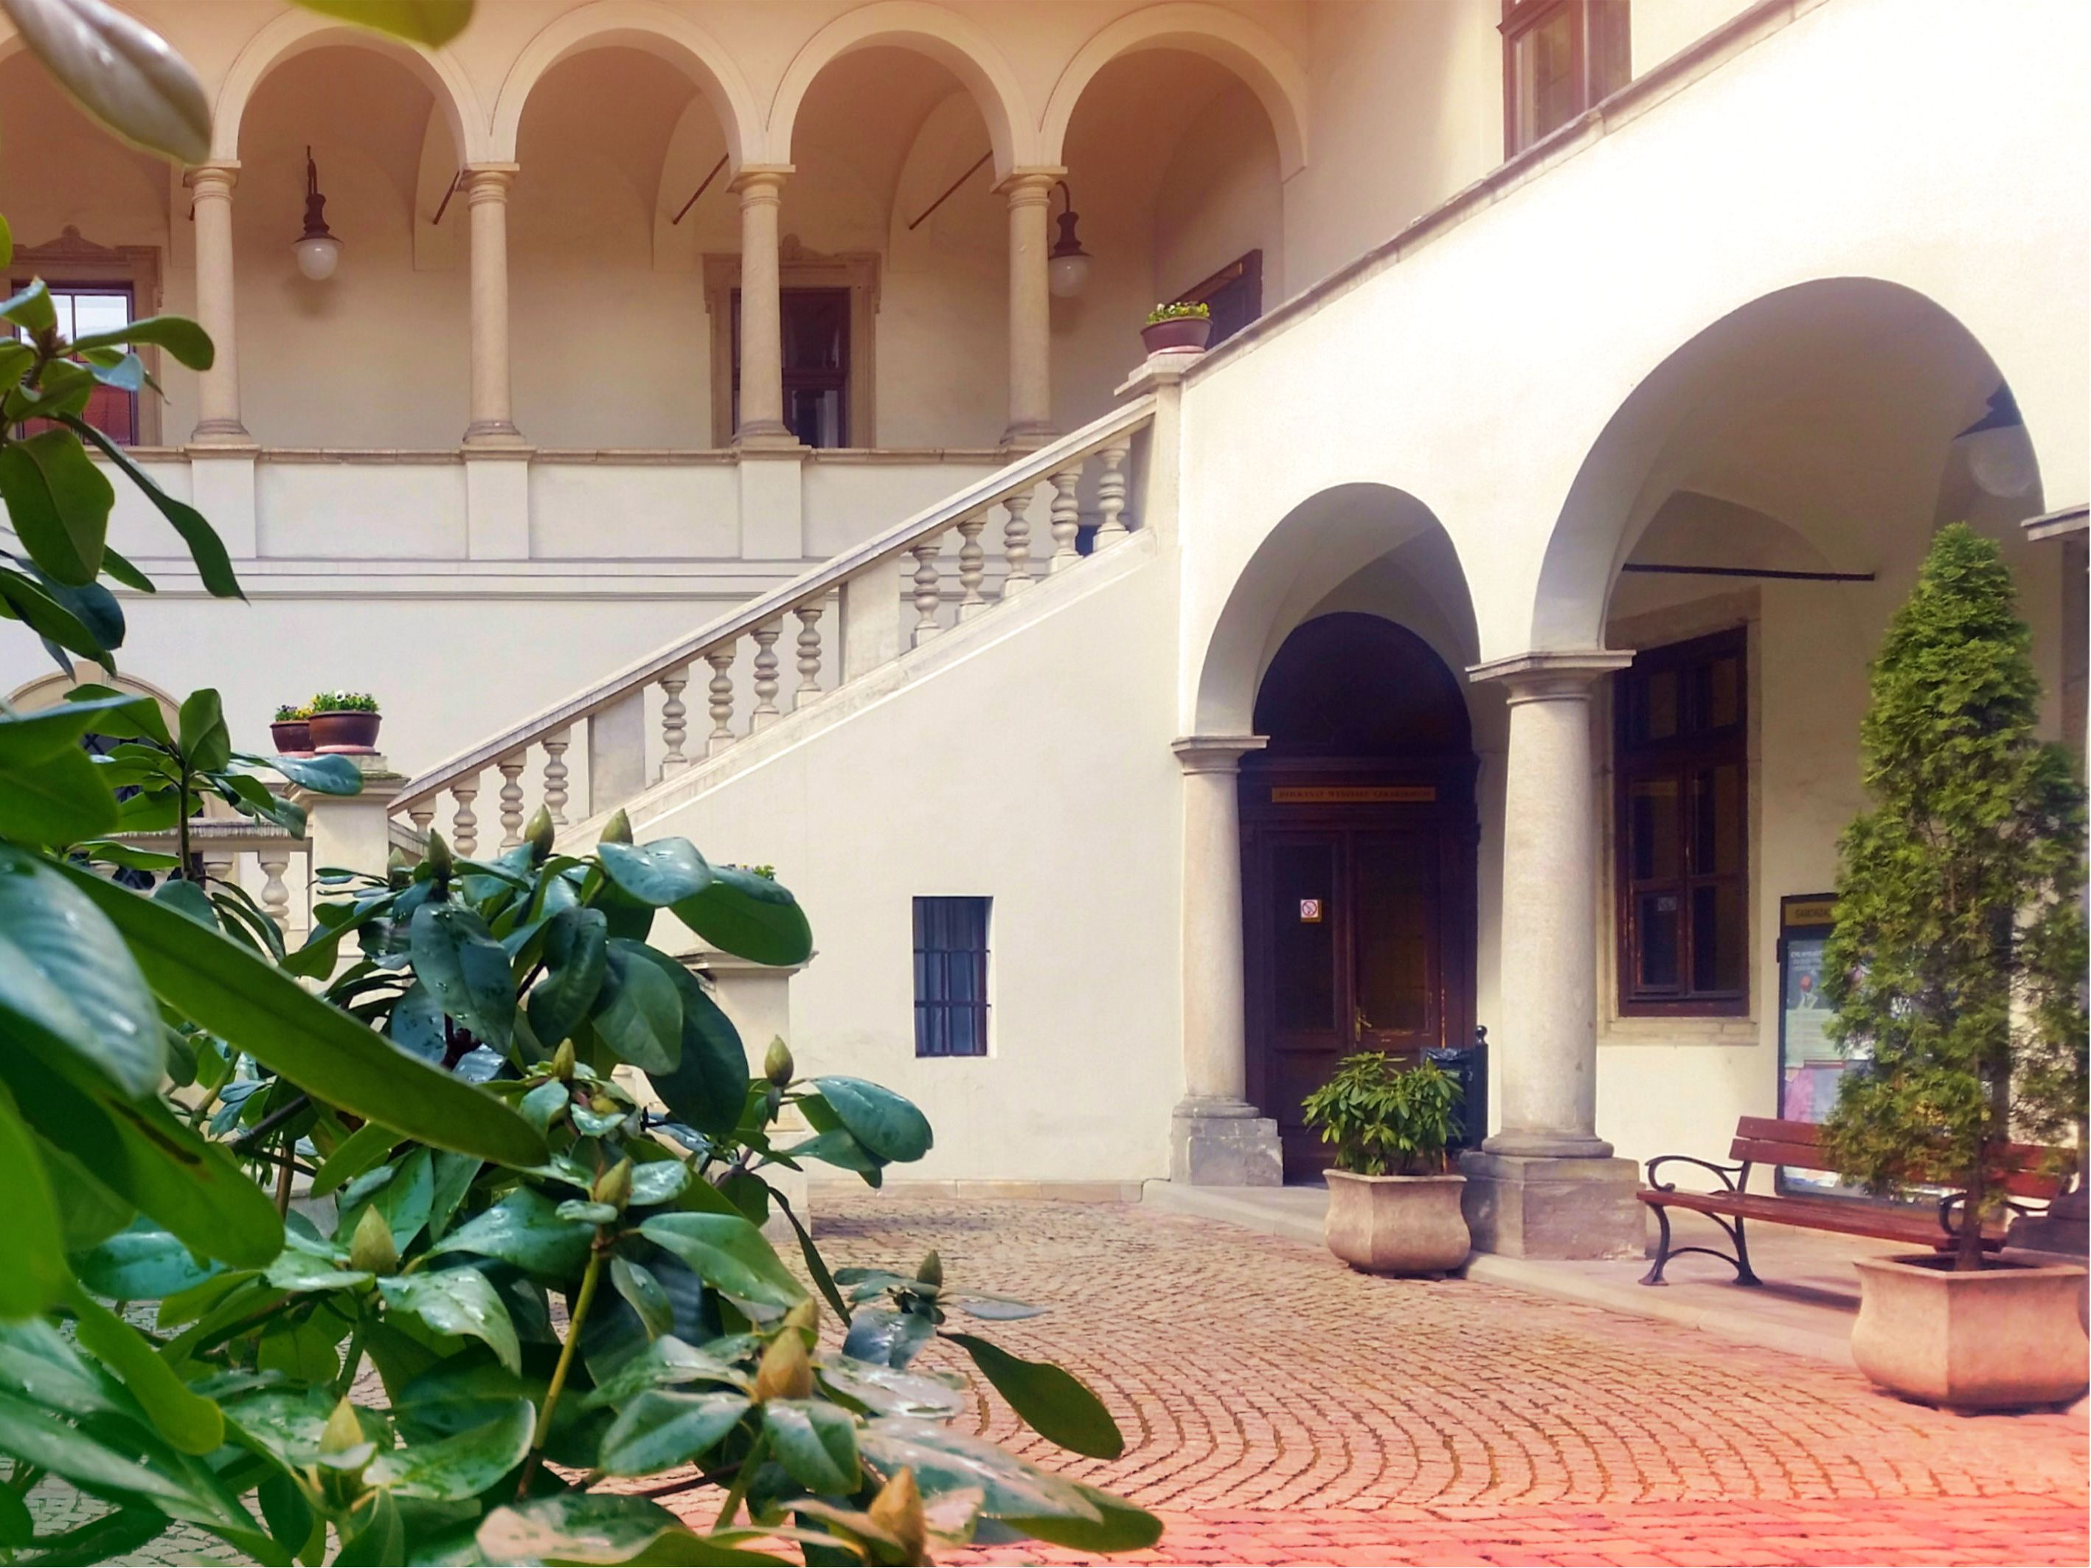
Jagiellonian University Medical College

Slide 5






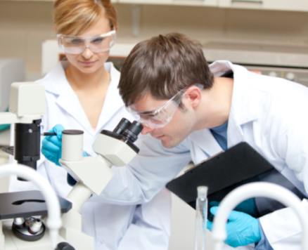
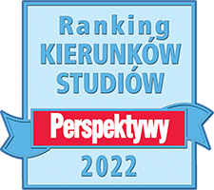
Jagiellonian University Medical College
3 FACULTIES
MORE THAN 5500 STUDENTS
PHARMACY
MEDICINE
HEALTH
SCIENCES
1600 ACADEMIC TEACHERS AND RESEARCHES, OF WHOM MORE THAN 170 ARE FULL PROFESSORS
SCHOOL OF MEDICINE IN ENGLISH
DOCTORAL SCHOOL OF MEDICAL AND HEALTH SCIENCES
WINNER OF THE MOST PRESTIGIOUS RANKING OF POLISH INSTITUTIONS OF HIGHER EDUCATION IN THE CATHEGORY OF MEDICAL UNIVERSITIES
POSTGRADUATE MEDICAL TRAINING CENTER

Slide 6

Internationalization and international cooperation

Slide 7
Internationalization and international cooperation
Studies in English:
Medical Doctor Programme
Doctor of Dental Surgery program
Drug Discovery&Development (MA)
Interdisciplinary PhD Programme
in Medical and Health Sciences
International networks
AUCSO
Baltic University Programme
COIMBRA Group
European University Association
EUNIS
EUROPAEUM
SAR
The Guild
Una Europa
Unitown
UTRECHT Network
Institutional cooperation:
NBME National Board
of Medical Examiners
AAMC Association
of American Medical Colleges (USA)
CARMS Canadian Resident Matching Service (Kanada)
Project cooperation
bilateral exchange agreements
with universities around the world
agreements Erasmus+
projects on cooperation for innovation and exchange of good practices
programme Europubhealth +

Slide 8

JUMC - science and research

Slide 9
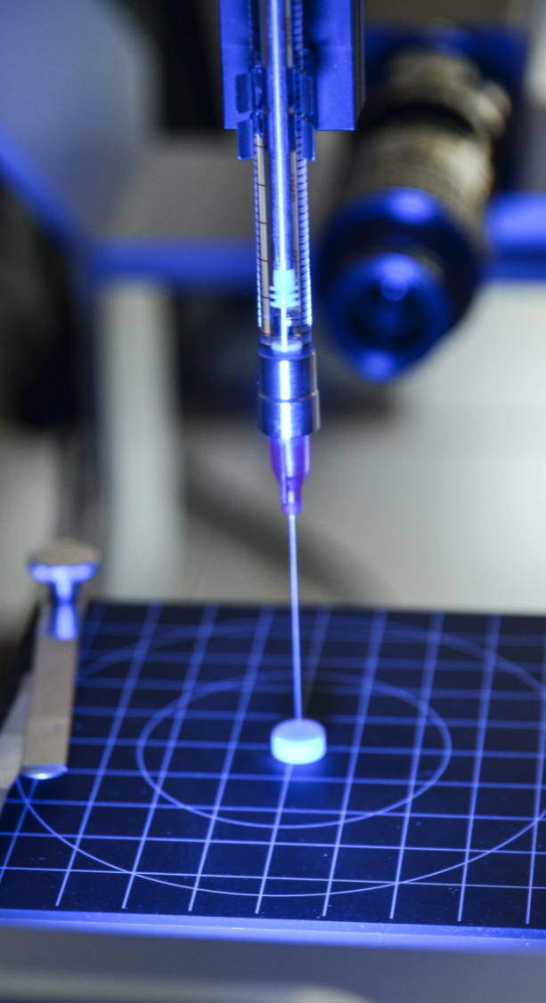

JUMC - science and research
modern research centers
state-of-the-art equipment
international research teams
hundreds of projects carried out each year
prestigous research grants
JU MC partakes in the Excellence Initiative – Research University program. As part of the qLife Priority Research Area “Quality of research for the quality of life”,
our scientists are realising research projects in:
social diseases and diseases of affluence;
reproductive health;
regenerative medicine.

Slide 10
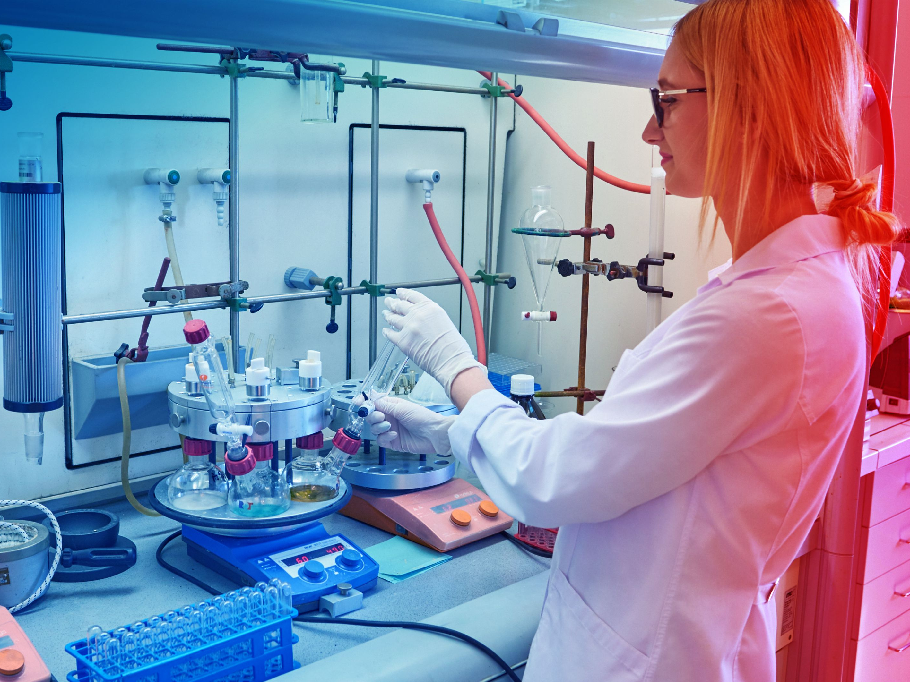
JUMC in rankings

Slide 11



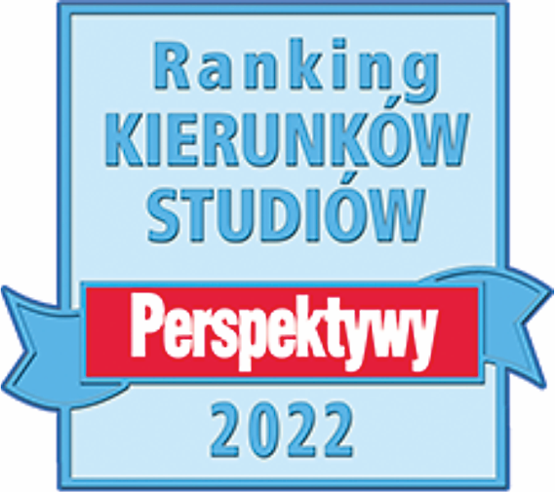

JUMC in rankings
Clinical Medicine – 201-300
Public Health – 101-150
Dentistry&Oral Sciences – 201-300
Medical Technology – 201-300
Pharmacy&Pharmaceutical Sciences – 201-300
Cardiac and Cardiovascular Systems – 190
Clinical Medicine – 170
Endocrinology and metabolism – 208
Neuroscience and behavior – 290
Pharmacology and toxicology – 193
Public, environmental and occupational health – 120
Medicine – 251-300
Pharmacy & Pharmacology – 201-250
Out of the 12 medical and health sciences study programms that were ranked, as many as 8 taught at the Jagiellonian University Medical College were recognized as the best in Poland:
• Medical Analytics
• Pharmacy
• Medicine
• Dentistry
• Nursing
• Midwifery
• Emergency Medical Services
• Public Health

Slide 12
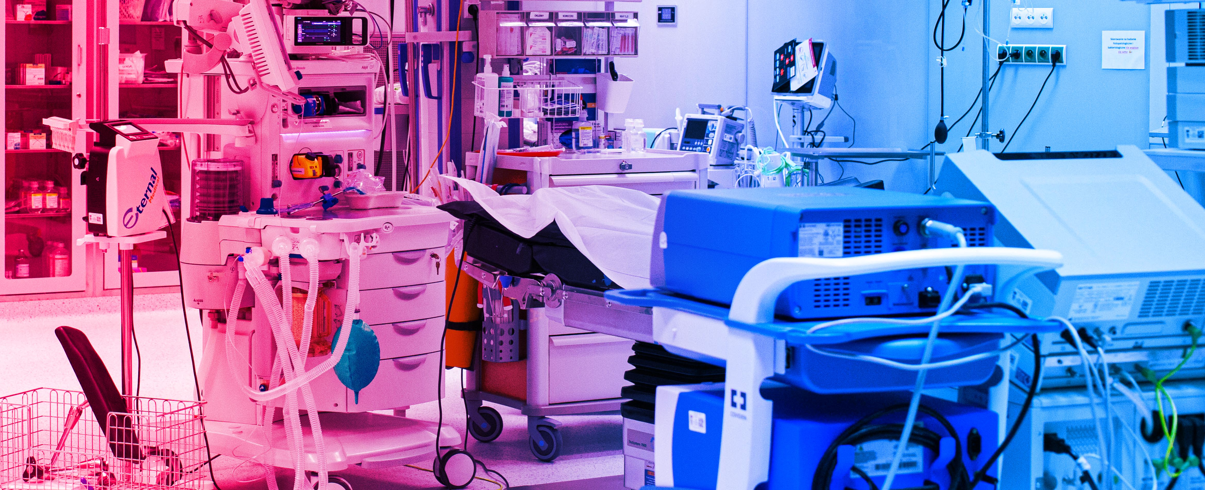
University Hospitals

Slide 13




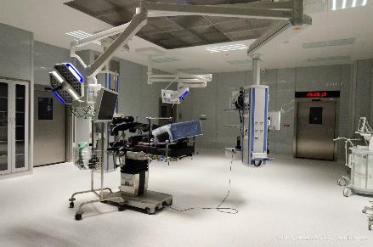
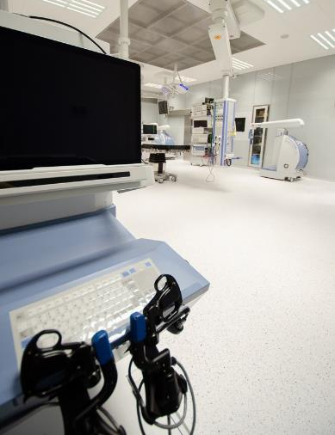
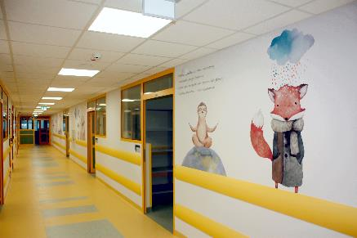
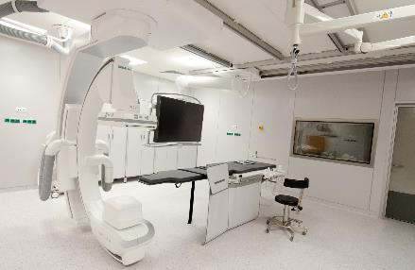
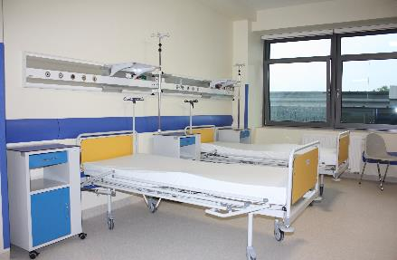
University Hospitals
The University
Hospital
The University
Children’s Hospital
The University
Dental Clinic
The Orthopedic-Rehabilitation
University Hospital

Slide 14
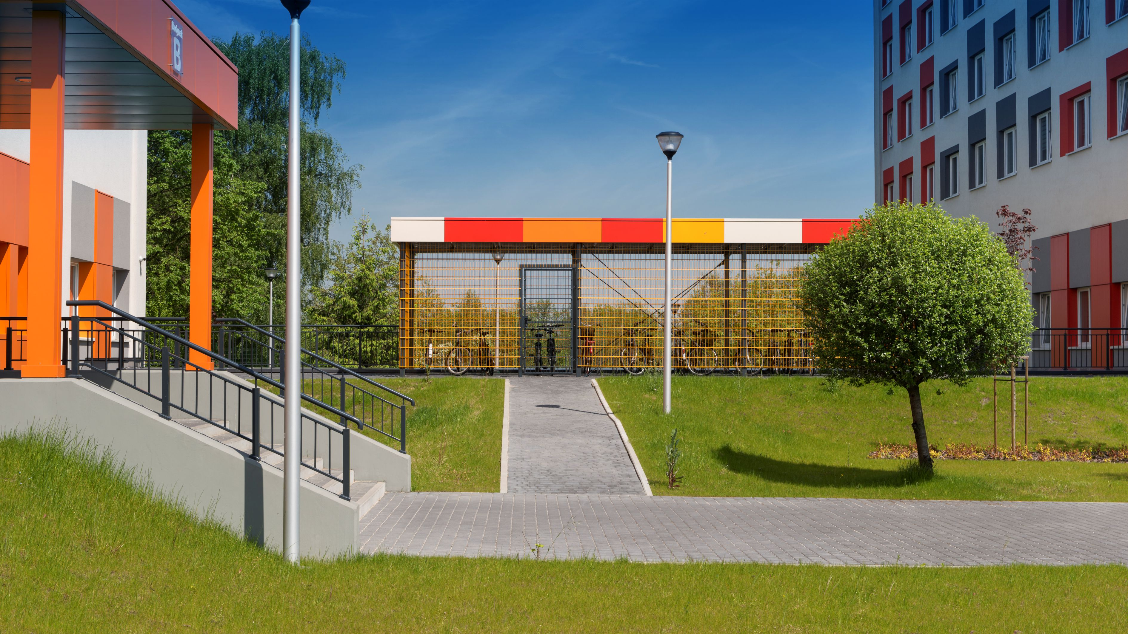
Medical Campus

Slide 15
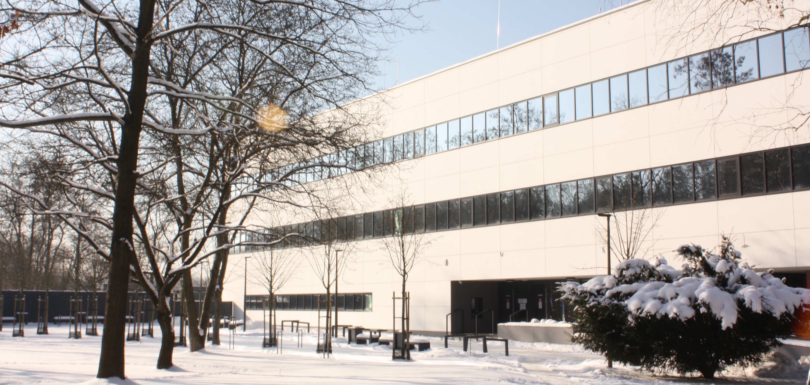
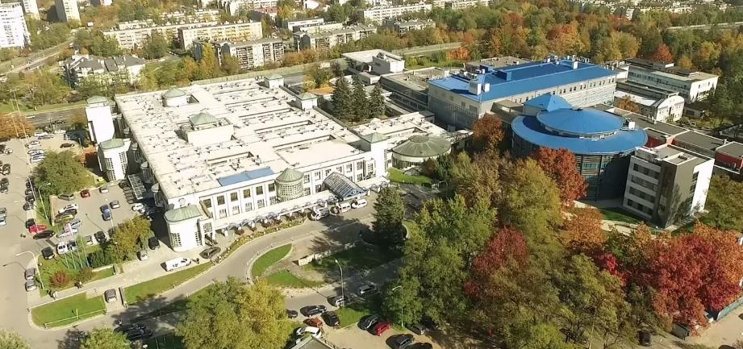
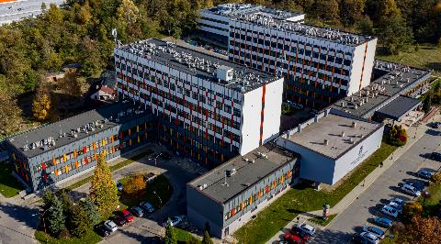
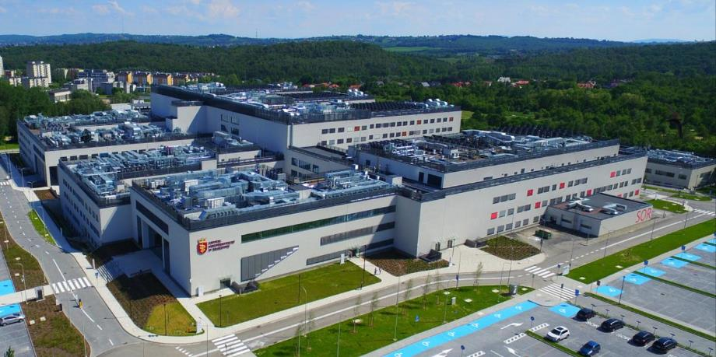
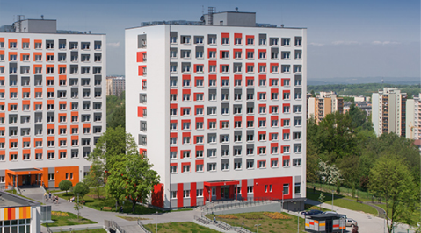
Medical Campus
Innovative Medical Education Center - didactic base for students in medicine, dentistry, nursing and midwifery
The University Children’s Hospital – the largest pediatric hospital in the region
University Hospital – the most modern hospital in Poland, a leading medical facility that combines experience and tradition with the latest trends in medicine
Faculty of Pharmacy
Dormitories with a sport complex

Slide 16
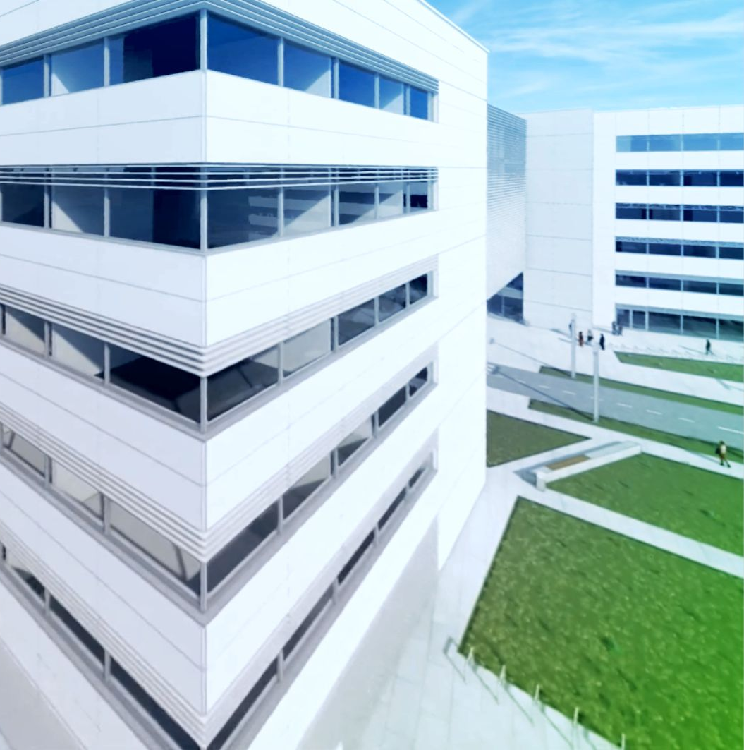
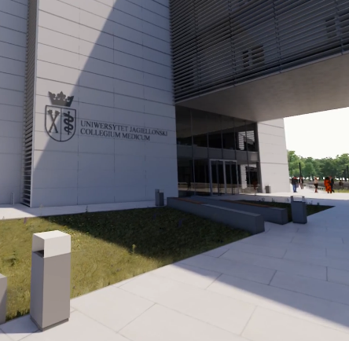
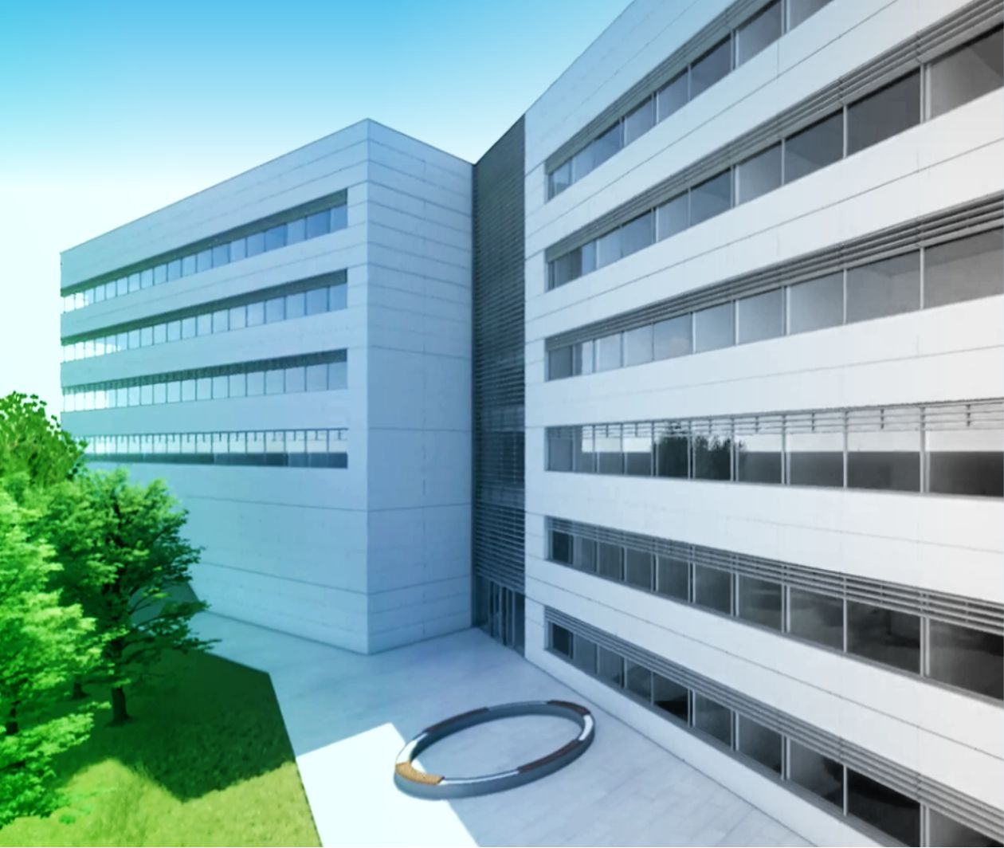
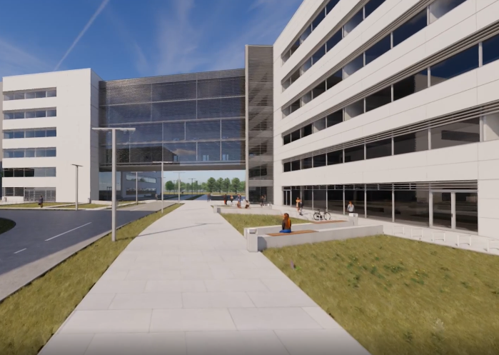
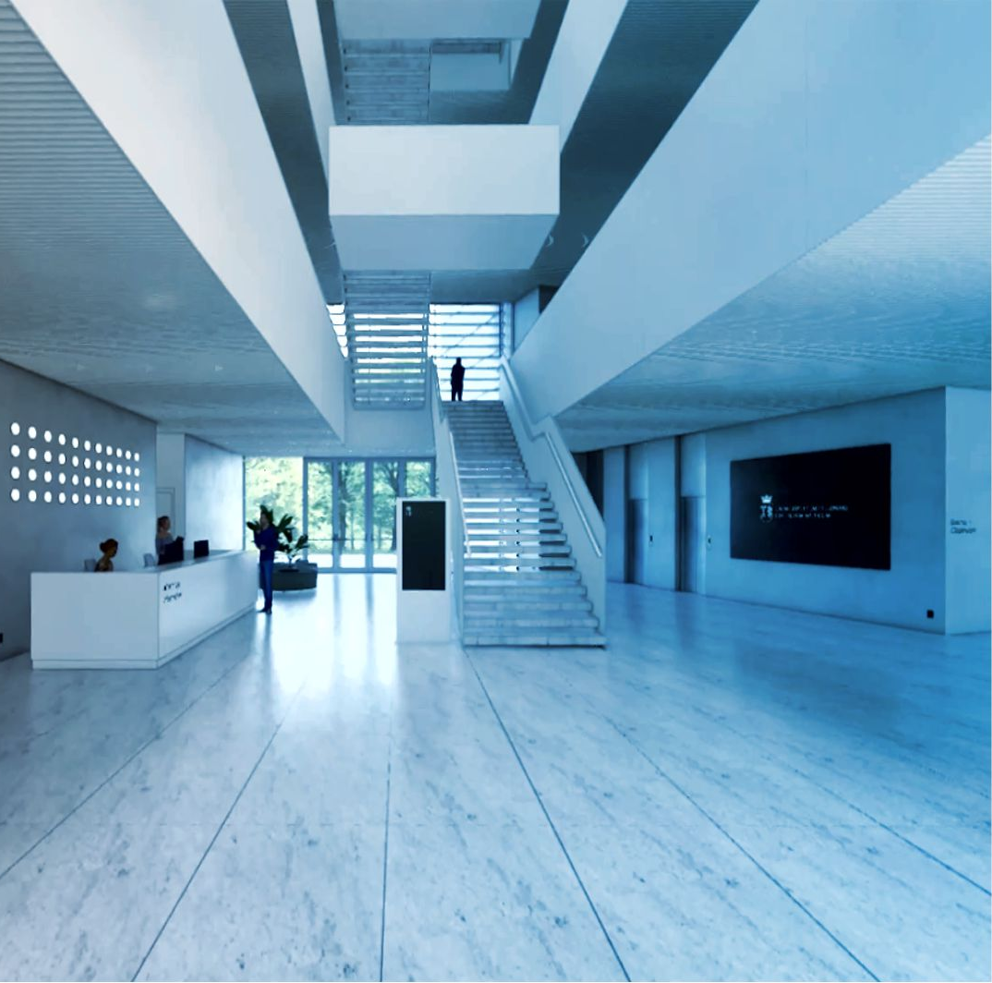
Investment Project - teaching and research center
Building laboratories, research modules, classrooms, and an animal facility is all part of the next development stage of the Medical Campus of the Jagiellonian University Medical College, which is the creation of a modern teaching and research center.
Such facilities will allow for a comprehensive employment of the scientific potential of the three faculties of the Jagiellonian University. Medical research in various areas from basic research, through optimization of treatment, to solving problems in the field of public health will be carried out here.

Slide 17

Collegium Novodvorscianum

Slide 18

www.cm-uj.krakow.pl/en
facebook.com/UJCMuniversity
instagram.com/collegium.medicum.uj
linkedin.com/company/uniwersytet-jagiellonski-collegium-medicum

