Slide 1



The best medical university in Poland
More than 650 years
of experience in teaching and research

Slide 2








Jagiellonian University
2022
16 faculties
177 majors
94 degree courses
4000 academic teachers and researches
40 000 students, PhD students
and postgraduate students
modern research centers
cooperation with prestigious foreign universities
leading teaching center
one of Europe’s
oldest universities
notable alumni:
Nicolaus
Copernicus
Pope
John Paul II
Wisława Szymborska
Nobel Prize winner
in literature 1996

Slide 3








Jagiellonian University – Medical College
3 FACULTIES
MORE THAN 5500 STUDENTS
PHARMACY
MEDICINE
HEALTH
SCIENCES
1600 ACADEMIC TEACHERS AND RESEARCHES, OF WHOM MORE THAN 170 ARE FULL PROFESSORS
SCHOOL OF MEDICINE IN ENGLISH
DOCTORAL SCHOOL OF MEDICAL AND HEALTH SCIENCES
WINNER OF THE MOST PRESTIGIOUS RANKING OF POLISH INSTITUTIONS OF HIGHER EDUCATION IN THE CATHEGORY OF MEDICAL UNIVERSITIES
POSTGRADUATE MEDICAL TRAINING CENTER

Slide 4
Internationalization and international cooperation
Studies in English:
International networks
AUCSO
Baltic University Programme
COIMBRA Group
European University Association
EUNIS
EUROPAEUM
SAR
The Guild
Una Europa
Unitown
UTRECHT Network
Medical Doctor Programme
Doctor of Dental Surgery program
Drug Discovery&Development (MA)
Interdisciplinary PhD Programme in Medical and Health Sciences
bilateral exchange agreements with universities around the world
agreements Erasmus+
projects on cooperation for innovation and exchange of good practices
programme Europubhealth +
Institutional cooperation:
Project cooperation
NBME National Board of Medical Examiners
AAMC Association of American Medical Colleges (USA)
CARMS Canadian Resident Matching Service (Kanada)

Slide 5
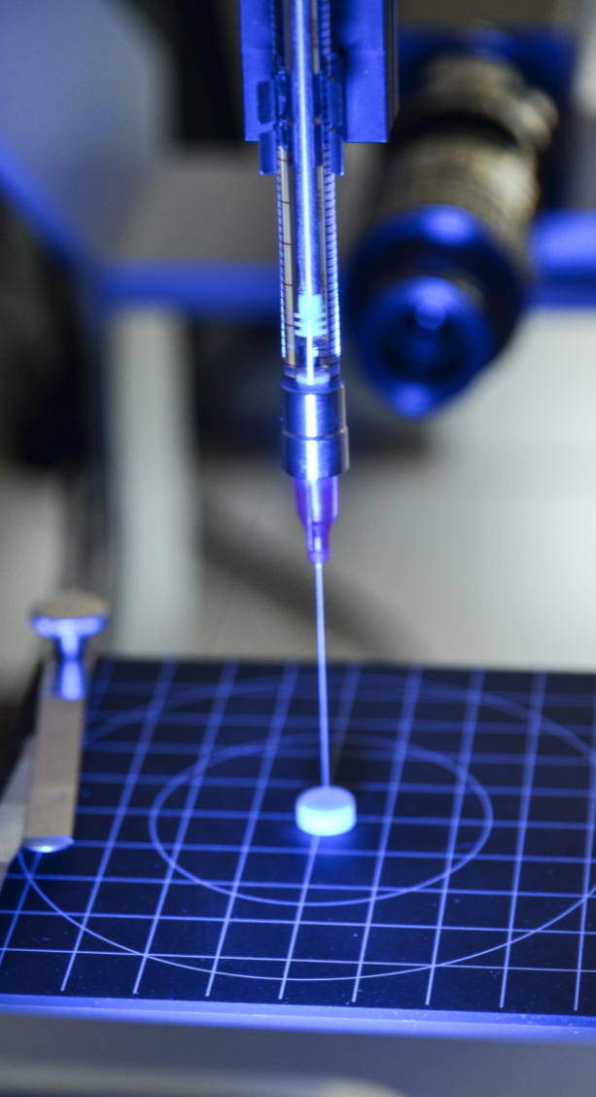
Scientific and research potential
modern research centers
state-of-the-art. Equipment
international research teams
hundreds of projects carried out each year
prestigous research grants
In 2021, the following were accomplished:
172 projects financed by the National Science Centre worth over PLN 120 million;
4 non-commercial clinical trials financed by the Medical Research Agency worth over PLN 49 million;
12 projects financed by The National Centre for Research and Development worth PLN 27.5 million;
13 Erasmus + projects financed by the European Commission valued at 700,000 euro,
10 projects financed under the Horizon 2020 program worth over EUR 2 million;
commercial projects as part of cooperation with the corporate sector,
9 Best of the Best projects! 4.0, aimed at supporting outstandingly talented students.

Slide 6
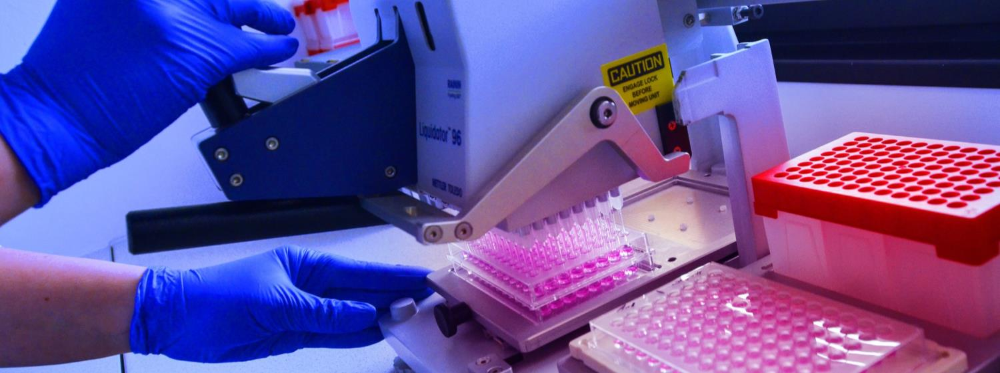
Research University program
JU MC partakes in the Excellence Initiative – Research University program. As part of the qLife Priority Research Area “Quality of research for the quality of life,” our scientists are realising research projects in:
social diseases and diseases of affluence;
reproductive health;
regenerative medicine.

Slide 7




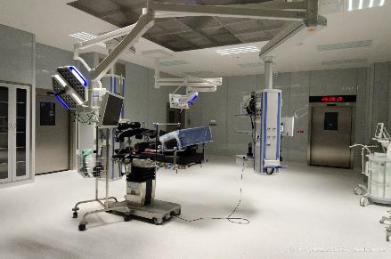
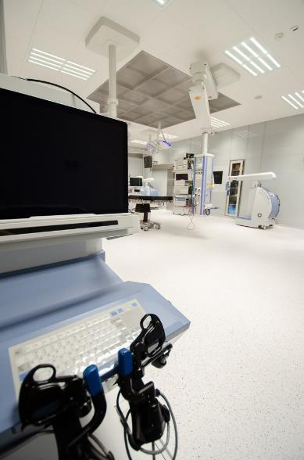
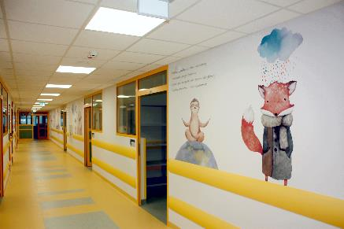
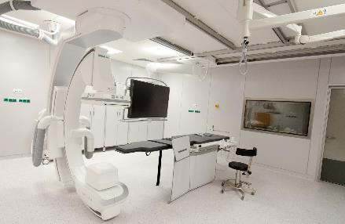
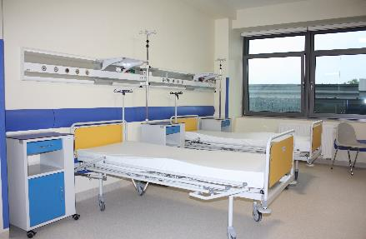

University Hospitals
The University
Hospital
The University
Children’s Hospital
The University
Dental Clinic
The Orthopedic-Rehabilitation
University Hospital

Slide 8
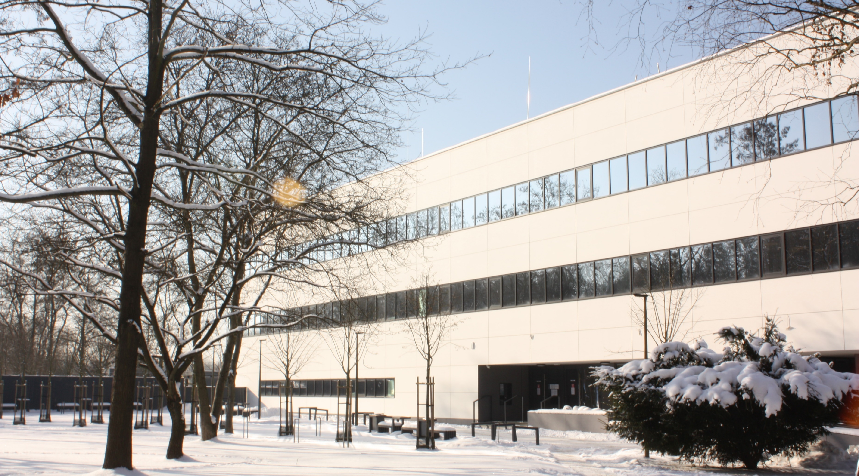
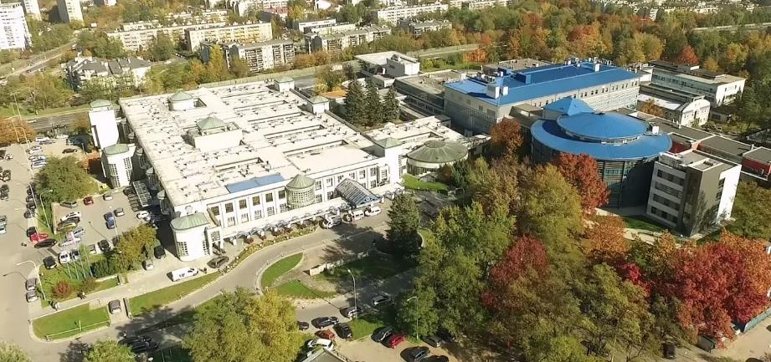
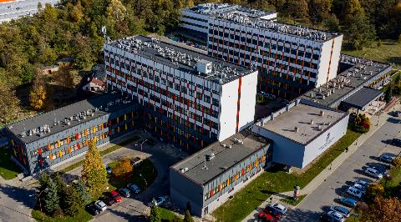
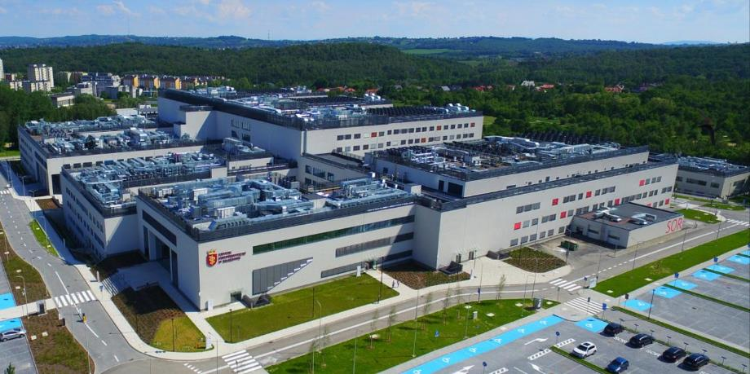
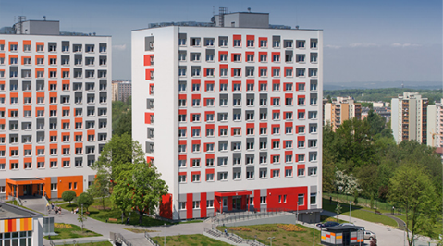
Medical Campus
Innovative Medical Education Center - didactic base for students in medicine, dentistry, nursing and midwifery
The University Children’s Hospital – the largest pediatric hospital in the region
Faculty of Pharmacy
Dormitories with a sport complex
University Hospital – the most modern hospital in Poland, a leading medical facility that combines experience and tradition with the latest trends in medicine

Slide 9

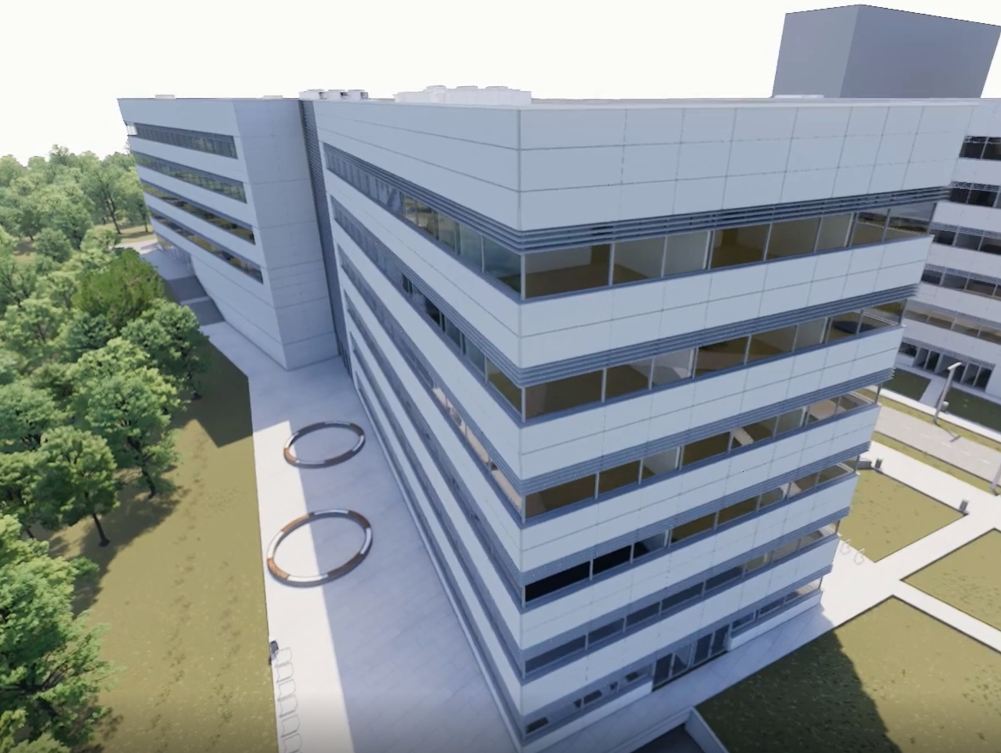

Investment Project - teaching and research center
Building laboratories, research modules, classrooms, and an animal facility is all part of the next development stage of the Medical Campus of the Jagiellonian University Medical College, which is the creation of a modern teaching and research center. Such facilities will allow for a comprehensive employment of the scientific potential of the three faculties of the Jagiellonian University. Medical research in various areas from basic research, through optimization of treatment, to solving problems in the field of public health will be carried out here.

Slide 10

www.cm-uj.krakow.pl/en
facebook.com/UJCMuniversity
instagram.com/collegium.medicum.uj
linkedin.com/company/uniwersytet-jagiellonski-collegium-medicum

